Slide 1

BABSAHEB BHIMRAO AMBEDKAR UNIVERSITY
LUCKNOW
DEPARTMENT OF COMPUTER SCIENCE
ILLUMINATING THE BLACKBOX
Explainable AI for Image Classification: A Comparative Study of GRAD-CAM, LIME, and SHAP
Akhlak Ansari Master of Technology(CS)
Roll No: 2403601
Session: 2024-26
Supervisor: Dr. Manoj Kumar
(Associate Professor)
@Department of Computer Science
1

Slide 2
Introduction & Motivation
Introduction
Deep Convolutional Neural Networks (CNNs) have achieved remarkable success in image classification tasks. Despite their high predictive performance, these models often behave as "black boxes," making it difficult to understand how decisions are made.
Motivation
High accuracy does not guarantee trust.
Critical domains require transparent decisions.
Explainability improves reliability and user confidence.
Understanding model behavior helps identify biases and errors.
2

Slide 3
Problem Statement & Research Gap
Problem Statement
Deep learning models provide accurate predictions but lack interpretability. Different Explainable AI techniques often generate different explanations for the same prediction.
Research Gap
Existing studies:
Evaluate individual XAI methods separately.
Use different datasets and architectures.
Lack standardized evaluation criteria.
Rarely compare methods under identical conditions.
Research Goal
To systematically compare Grad-CAM, LIME, and SHAP using a unified framework
3

Slide 4
Research Objectives
Main Objective
Develop an explainable image classification framework and evaluate major XAI techniques.
Specific Objectives
Train a ResNet-18 image classifier.
Generate explanations using Grad-CAM.
Generate explanations using LIME.
Generate explanations using SHAP.
Evaluate explanation quality using multiple metrics.
Identify strengths and limitations of each method.
Simple objective flow diagram
Objectives → Training → Explanation → Evaluation
4

Slide 5
Literature Review
Evolution of CNN Architectures
AlexNet introduced deep CNNs.
VGG improved feature extraction depth.
Inception increased computational efficiency.
ResNet solved vanishing gradient problems using residual learning.
Evolution of Explainability
Saliency Maps
Grad-CAM
LIME
SHAP
Integrated Gradients
5

Slide 6
Dataset Description
Cats vs Dogs Dataset
The dataset contains images of cats and dogs collected for binary image classification.
Category | Images
Cats | 2000
Dogs | 2000
Total | 4000
Data Split
Training Set: 70%
Validation Set: 20%
Test Set: 10%
Image Size
128 × 128 RGB
6

Slide 7
Proposed System Architecture
Framework Overview
The proposed framework consists of:
Dataset Collection
Image Preprocessing
CNN Training
Prediction Generation
Explanation Generation
Quantitative Evaluation
Comparative Analysis
The system integrates classification and explainability into a unified pipeline.
7

Slide 8

Resnet-18 Model Architecture​
Why ResNet-18?
ResNet-18 was selected because it offers a balance between computational efficiency and classification performance.
Advantages
Residual Learning
Faster Convergence
Reduced Vanishing Gradient
Lightweight Architecture
Residual Mapping
$$y=F\left(x , W\right)+x$$
Architecture Summary
18 Layers
Residual Blocks
Approximately 11 Million Parameters
8

Slide 9
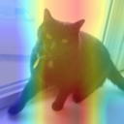
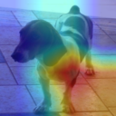
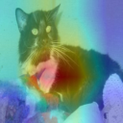
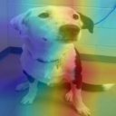
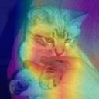
Explainability Method 1- GRAD-CAM​
Working Process
Forward Propagation
Gradient Computation
Feature Map Weighting
Heatmap Generation
Advantages
Fast execution
Easy visualization
Suitable for CNNs
Limitations: Produces low-resolution localization maps.
9

Slide 10
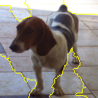
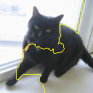
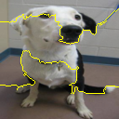
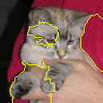
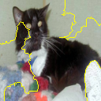
Explainability Method 2- LIME
Workflow
Segment image into superpixels.
Create perturbed samples.
Observe prediction changes.
Train local surrogate model.
Advantages
Model Agnostic
Human Readable
Limitations
Computationally expensive
Sensitive to segmentation strategy
10

Slide 11
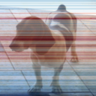
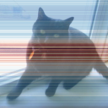
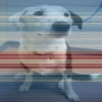
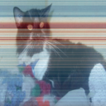
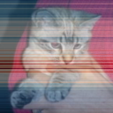
Explainability Method 3- SHAP
SHapley Additive Explanations
SHAP uses concepts from cooperative game theory to assign importance values to image regions.
Characteristics
Strong mathematical foundation
Consistent feature attribution
Global and local interpretability
Characteristics
Strong mathematical foundation
Consistent feature attribution
Global and local interpretability
Limitations
High computational cost
Increased memory usage
11

Slide 12
Evaluation Framework
Confidence Drop
Measures confidence reduction after removing important pixels.
Sparsity
Measures concentration of explanations.
Occulation Senstivity
Measures prediction changes when image regions are masked.
AOPC
Average confidence decrease caused by progressive perturbations.
Importance
Using multiple metrics provides a more comprehensive evaluation than relying on a single measure.
12

Slide 13
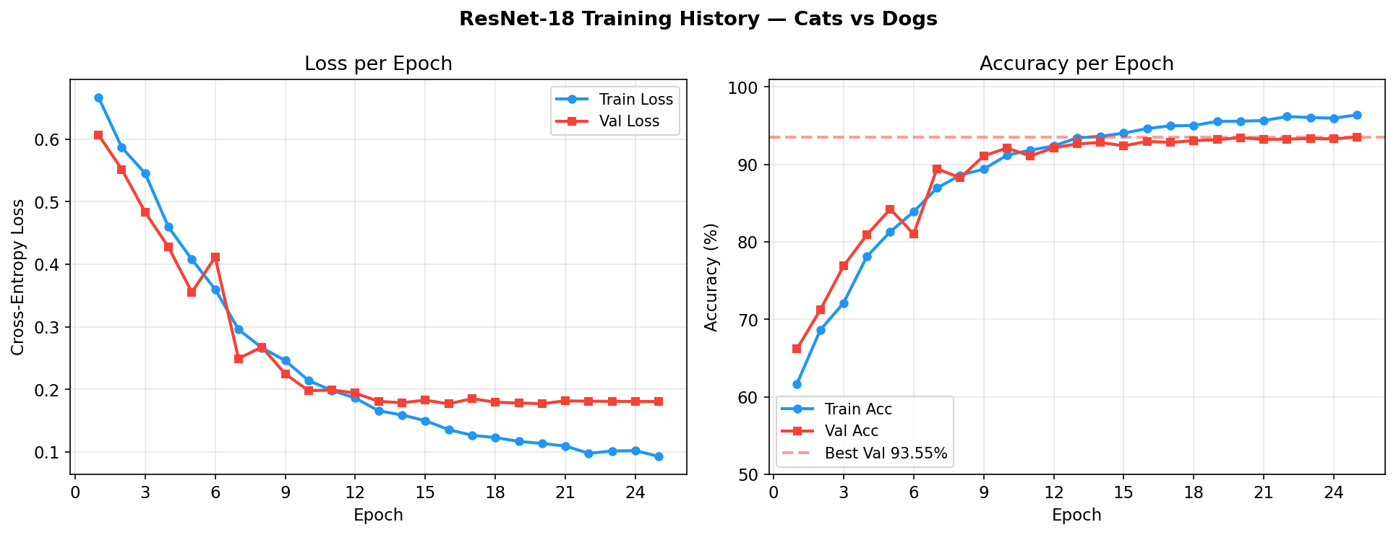
Model Performance Result
Training Performance​
The ResNet-18 model achieved strong classification performance.
Observations
Stable convergence.
Low overfitting.
Good generalization ability.
Metric | Value
Training Accuracy | 96.40%
Validation Accuracy | 93.55%
13

Slide 14
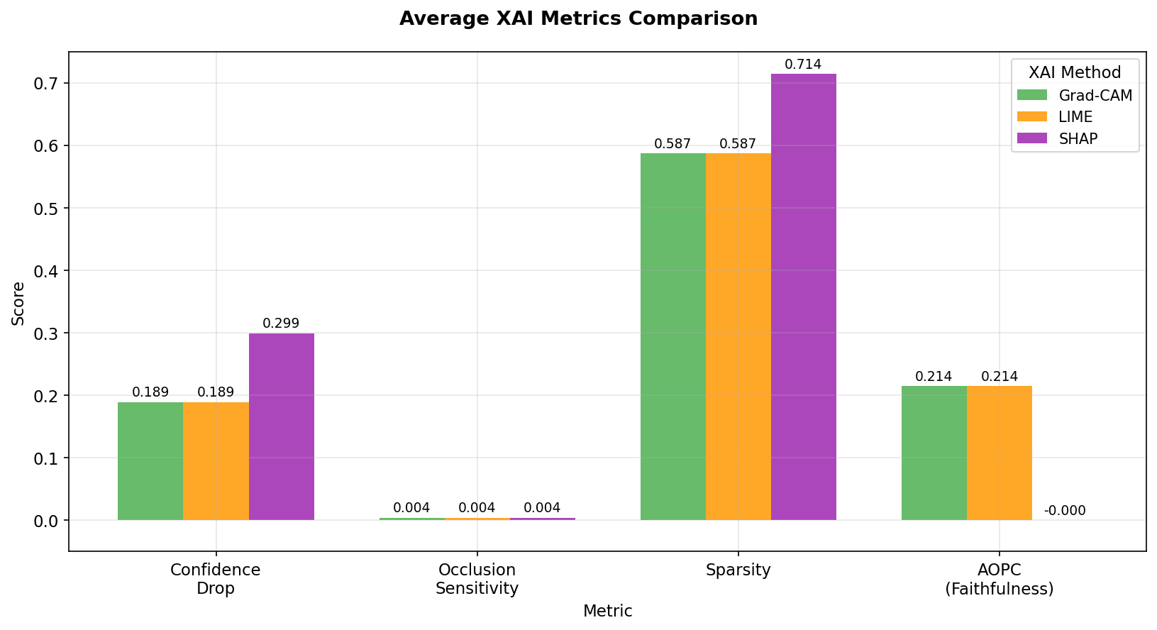
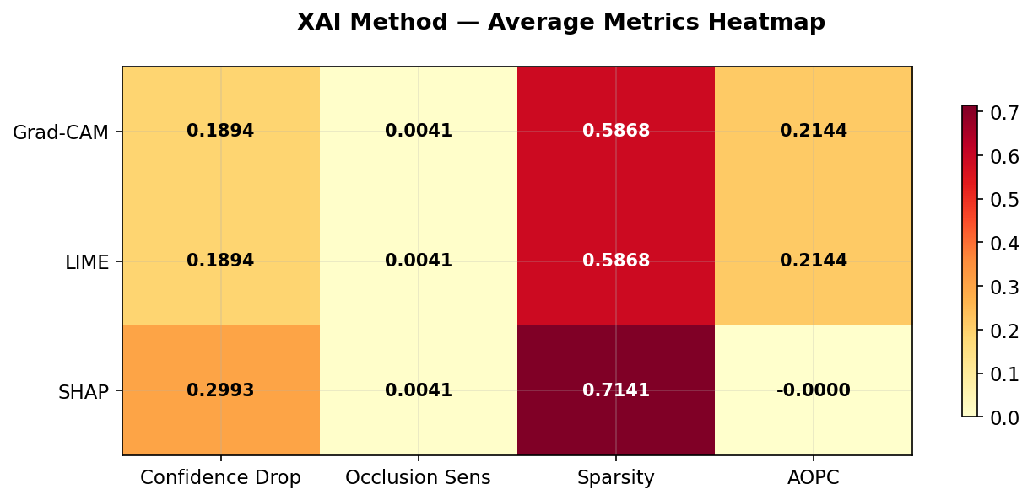
Comparative Analysis of XAI Methods
GRAD-CAM
Fastest explanation generation.
Effective visual localization.
SHAP
Highest attribution quality.
Strong theoretical basis.
LIME
Works with any model.
Provides intuitive superpixel
explanations.
Conclusion
No single method dominates all evaluation metrics.
14

Slide 15
Contributions, Conclusion & Future Work
Contributions
✓ Developed complete XAI framework.
✓ Trained and evaluated ResNet-18 classifier.
✓ Implemented Grad-CAM, LIME and SHAP.
✓ Designed multi-metric evaluation methodology.
✓ Provided comparative insights for XAI selection.
Futurte Work
Vision Transformers
Medical Imaging
Explainable Object Detection
Human-Centered Evaluation
Real-Time Explainable AI Systems
Conclusion
ResNet-18 achieved 93.55% validation accuracy.
Grad-CAM offers efficient visual explanations.
LIME provides model-independent interpretability.
SHAP delivers strong attribution quality.
Different applications may require different explanation techniques.
15

Slide 16

Thank You
akhlakansari00786@gmail.com
@akhlak919
16

